Slide 1
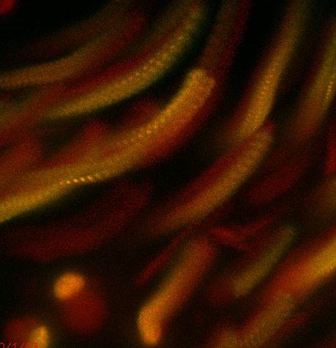
Three-dimensional fluorescence live imaging
Notes:
1
For this class, I am going to talk to you live imaging and in particular 3-D fluororescence imaging. I know you had information about TIRF and DIC imaging and in later sections you will be talking about FRET, PALM/STORM. So I won’t touch upon those subjects. So instead I will be focusing on general challenges one finds when doing live imaging. I also will be using some data from my lab in trying to determine the kinetics of synapsis assembly during meiosis as a way to illustrate some of the important considerations one has to take when imaging a live biological process.
----- Meeting Notes (3/28/13 11:42) -----
Really this lecture should really be about distinguishing the living from the zombies, essentially the living dead.

Slide 2
Key Elements for Successful Live Imaging
Choice of biological specimen
Validation
Reducing photoxicity and photobleaching
Close preservation of normal environment

Slide 3
Meiosis
MI
MII
Replication
Homolog Pairing
Recombination
Synaptonemal Complex
Notes:
3
3
During prophase of meiosis I, homologs become intimately associated through pairing interactions that are further stabilized by synapsis via the assembly of the synaptonemal complex. The synaptonemal complex is a highly organized, proteinaceous structure that forms between homologous chromosomes. Besides maintaining tight association between the homologs, the synaptonemal complex is thought to have an important role in promoting the resolution of recombination intermediates.
homologous segregation - pairing, recombination and synapsis
Different organisms do things differently.
Meiosis diploid and results four haploid progeny, in mammals progeny are the sperm and egg and in the budding yeast they are known as spores

Slide 4
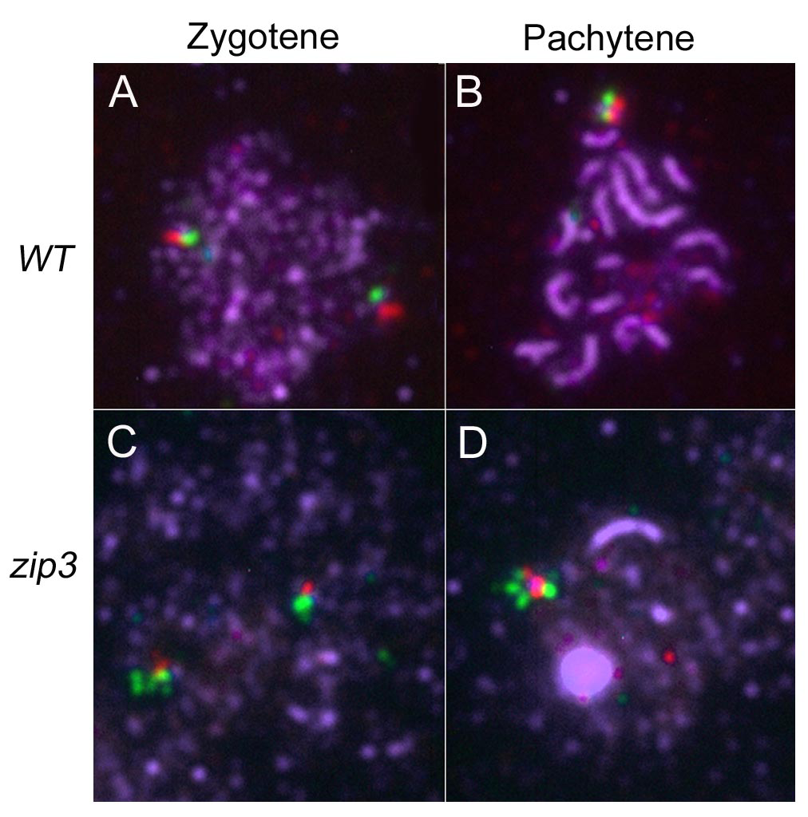
Progression of Synapsis in Fixed Budding Yeast Spreads
Synapsis
FISH probe Chromosome 3
FISH probe Chromosome 3

Slide 5
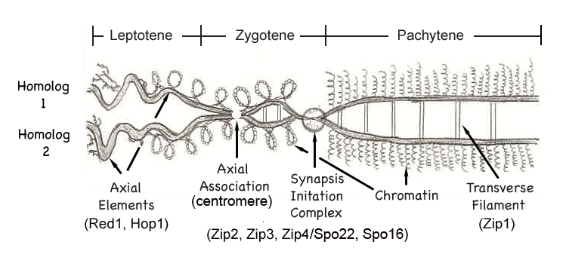
Open Questions about Synaptonemal Complex Assembly
What is the rate, extent and direction of synapsis formation?
Is synapsis continuous, stepwise or dynamically assembled and disassembled?
Does the kinetics of synapsis nucleation differ at centromeric vs. noncentromeric sites?
Do the kinetics of synapsis play a role in controlling the distribution of crossovers?
How is synapsis disassembled?
How long does the whole process take?
When is synapsis established relative to pairing?
Notes:
There are many questions that still are either unclear or unanswered about synapsis formation that could be addressed if we could characterize in vivo synaptonemal complex assembly. Some of the ones we are interested in pursuing are listed here.
Many questions remain about SC assembly that knowing the dynamics of SC assembly and disassembly can shed light into. In this talk, I am not going to provide the answer to all these questions but what I will show you it that we are very close to attaining the answers to many of these questions.
Another test would be a temporal test in order for synapsis to be relevant the extention of the synapsis should kinetics of synapsis propagation mechanism and kinectics of propagation

Slide 6
Choosing the Appropriate Organism to
Answer your Question
Easily transfected/transformed or easily take up labeled proteins or dyes
Biological process can be found at sufficient frequency
The biological process completes in a reasonable amount of time
The process can be sustained over the time it takes to image
Not imaging a process that occurs too deep into the tissue
The time resolution isn’t beyond the imaging capabilities
Ways to validate your results?

Slide 7
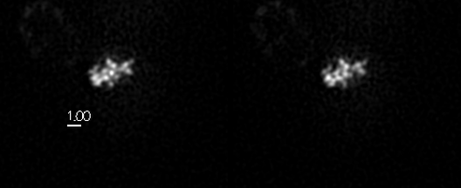
Imaging Synapsis in WT Budding Yeast Cells
16 chromosomes are synapsing within a confined space
Moving rapidly (1 micron/sec)
Nucleation is occurring at 50-70 sites, potentially simultaneously
Notes:
7
Fast z stack – pseudo stereo pairs (projections) The idea is that during the exposure you change focus rapidly while translating in x.

Slide 8
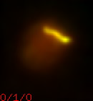
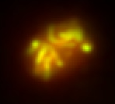
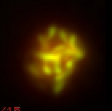
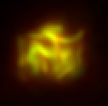
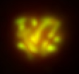
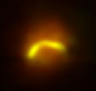
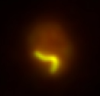
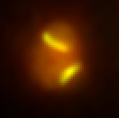
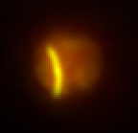
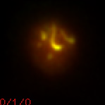
Synapsed Chromosomes Imaged in a ∆zip3 Mutant
ZIP3+
∆zip3
zip1::LEU2
ura3-1
∆zip3::LYS2
zip1::LEU2
Zip1-GFP(∆3’UTR)@URA3
∆zip3::LYS2
Notes:
Frequency of event that you are observing matters.

Slide 9
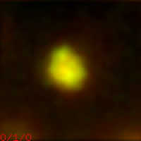
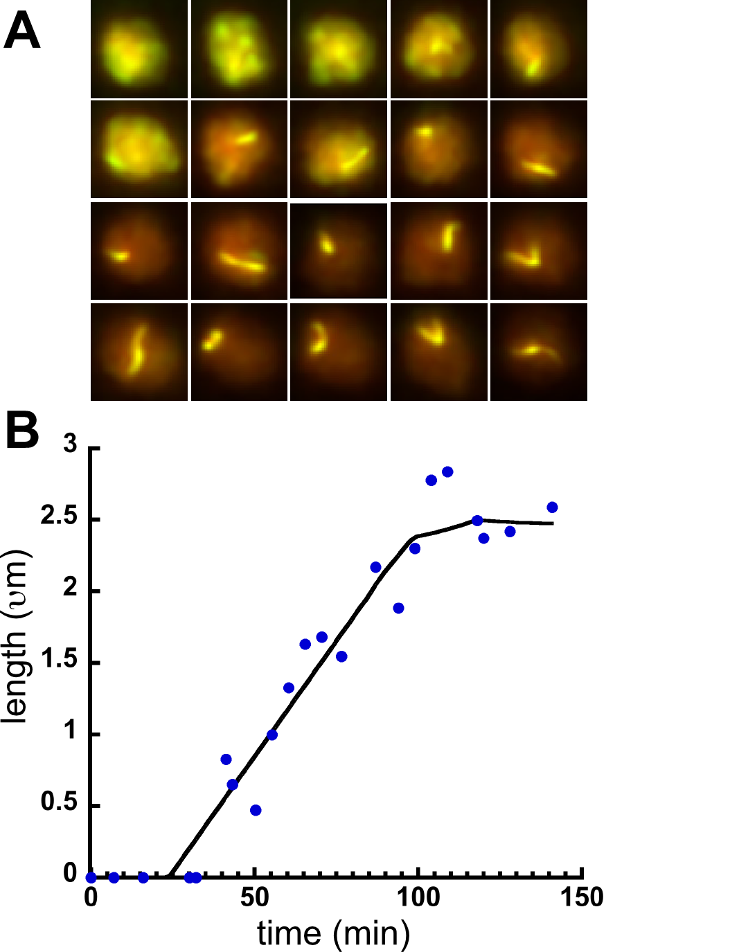
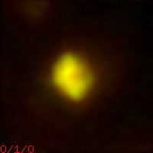
Synapsis Formation is Progressive
Continuous
length
time
Step-wise
length
(μm)
time
Assembly/Disassembly
rate = 5 x 10⁻⁴ μm/s
completion = 75 min
length
time

Slide 10
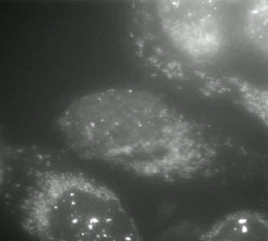
Imaging Under NonOptimal Conditions
UMUC3 cancer cells expressing a mTagBFP labeled 53BP1 (DNA damage sensor) fragment
(405nm arc lamp exposure every minute for about an hour, no heat or CO2)
Images courtesy of Beth Cimini

Slide 11
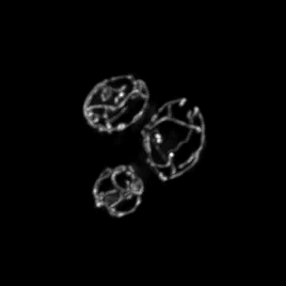
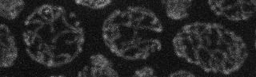
GFP targeted to the mitochondrial matrix imaged under nonoptimal conditions
Z-stack taking every 20 secs for 200 secs
(wide-field deconvolution – high light levels)
Z-stack taking every 1 secs for 200 secs
(spinning disk confocal – low light levels
Images courtesy of Susanne Rafelski
Notes:
GFP targeted to the mitochondrial matrix
cells grown in the CellAsic and imaged with the super-fast piezo acquisition on the spinning disk at low light levels. Each Z-stack takes ~1sec and so the entire 200frames is the same amount of time as the previous movie's 10 frames...

Slide 12
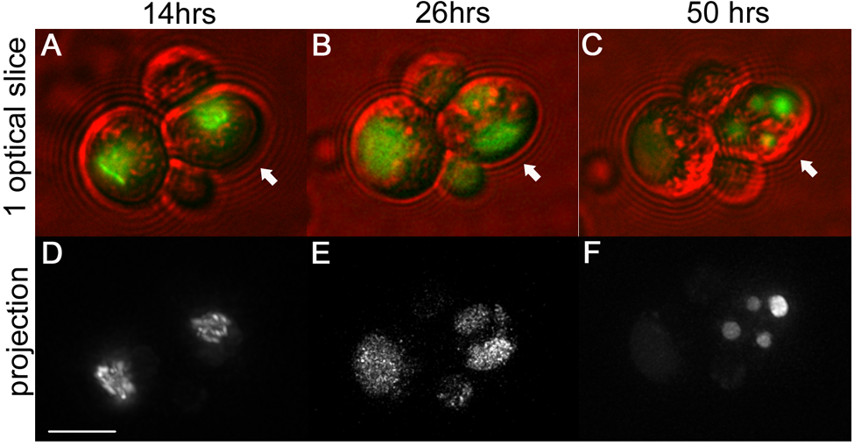
Using Meiotic Progression to Evaluate Phototoxicity

Slide 13
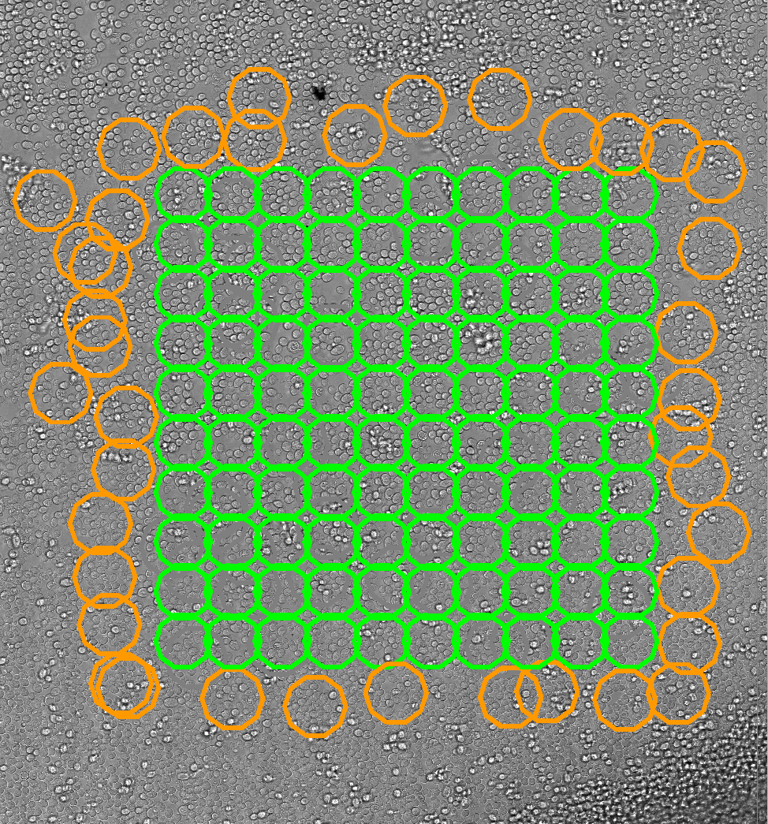
Tetrad Formation 3 fold decreased in imaged areas
Imaging Area
Not Imaged Area
Tetrads
>
3X
1X
Notes:
24 timepoints every hour after 15 -16 every 4 hours (3 fold differences)

Slide 14
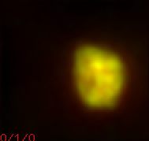
Photoxicity Affects Chromosome Synapsis
Notes:
Reduce dose I don’t see the effect.

Slide 15
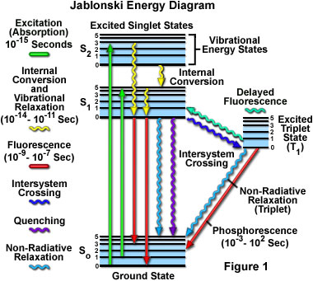
¹O₂
hν
O₂
Notes:
Instead of emitting fluorescence, te energy is transferred to an triplet state which can convert O2 in the highly reactive singlet O2 state

Slide 16
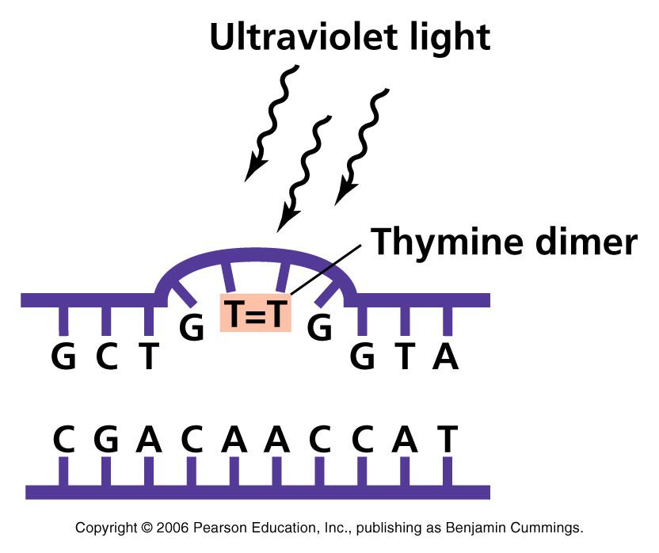
Biological Harmful Effects of Free Radicals
Because of its highly reactive nature (unpaired electron) singlet O₂
will attack sites of high electron density -e.g. C=C, N atoms.
Lipid peroxidation
Protein modification
DNA modification
¹O₂
¹O₂
Notes:
Reactive oxygen species (ROS) is a phrase used to describe a variety of molecules and free radicals (chemical species with one unpaired electron) derived from molecular oxygen. Molecular oxygen in the ground state is a bi-radical, containing two unpaired electrons in the outer shell (also known as a triplet state). Since the two single electrons have the same spin, oxygen can only react with one electron at a time and therefore it is not very reactive with the two electrons in a chemical bond. On the other hand, if one of the two unpaired electrons is excited and changes its spin, the resulting species (known as singlet oxygen) becomes a powerful oxidant as the two electrons with opposing spins can quickly react with other pairs of electrons, especially double bonds.
The basis of PDT is the interaction of light with photosensitive agents to produce an energy transfer and a local chemical effect. This is broadly similar to what is seen in photosynthesis, although in this case, many photosensitizers work together to harvest light energy to produce chemical reactions. Of the many photosensitizers that have been used in PDT, each has its own unique excitation properties. Usually, the photosensitizer is excited from a ground singlet state to an excited singlet state. It then undergoes intersystem crossing to a longer-lived excited triplet state.
One of the few chemical species present in tissue with a ground triplet state is molecular oxygen. When the photosensitizer and an oxygen molecule are in proximity, an energy transfer can take place that allows the photosensitizer to relax to its ground singlet state, and create an excited singlet state oxygen molecule. Singlet oxygen is a very aggressive chemical species and will very rapidly react with any nearby biomolecules.

Slide 17
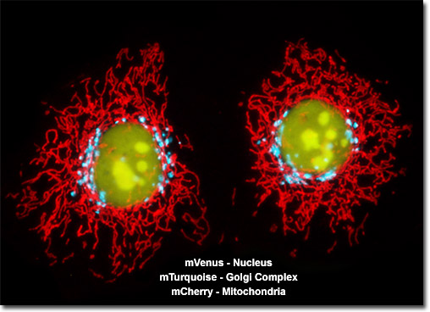
Multi-wavelength Imaging Increases Photoxicity

Slide 18
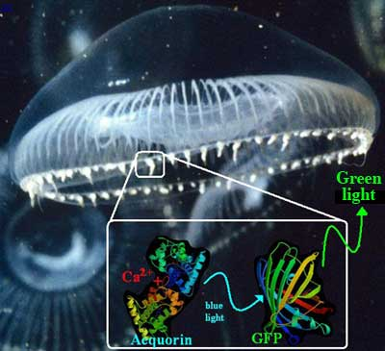
Green Fluorescent Protein
Notes:
Aequorea victoria, Discovered in the 1960s but became of great interest after it was cloned and shown to function fused to proteins in bacteria and nematodes.

Slide 19
Genetically Encoded Fluorescent Fusion Proteins
Protein | Excitation | Emission | Molar | Quantum | in vivo | Relative
(Acronym) | Maximum | Maximum | Extinction | Yield | Structure | Brightness
 | (nm) | (nm) | Coefficient |  |  | (% of EGFP)
GFP (wt) | 395/475 | 509 | 21,000 | 0.77 | Monomer* | 48
Green Fluorescent Proteins
EGFP | 484 | 507 | 56,000 | 0.6 | Monomer* | 100
Emerald | 487 | 509 | 57,500 | 0.68 | Monomer* | 116
Superfolder GFP | 485 | 510 | 83,300 | 0.65 | Monomer* | 160
Blue Fluorescent Proteins
EBFP | 383 | 445 | 29,000 | 0.31 | Monomer* | 27
EBFP2 | 383 | 448 | 32,000 | 0.56 | Monomer* | 53
Azurite | 384 | 450 | 26,200 | 0.55 | Monomer* | 43
mTagBFP | 399 | 456 | 52,000 | 0.63 | Monomer | 98
Cyan Fluorescent Proteins
ECFP | 439 | 476 | 32,500 | 0.4 | Monomer* | 39
mECFP | 433 | 475 | 32,500 | 0.4 | Monomer | 39
Cerulean | 433 | 475 | 43,000 | 0.62 | Monomer* | 79
mTurquoise | 434 | 474 | 30,000 | 0.84 | Monomer* | 75
Yellow Fluorescent Proteins
EYFP | 514 | 527 | 83,400 | 0.61 | Monomer* | 151
Topaz | 514 | 527 | 94,500 | 0.6 | Monomer* | 169
Venus | 515 | 528 | 92,200 | 0.57 | Monomer* | 156
mCitrine | 516 | 529 | 77,000 | 0.76 | Monomer | 174

Slide 20
Genetically Encoded Fluorescent Fusion Proteins
Protein | Excitation | Emission | Molar | Quantum | in vivo | Relative
(Acronym) | Maximum | Maximum | Extinction | Yield | Structure | Brightness
 | (nm) | (nm) | Coefficient |  |  | (% of EGFP)
Orange Fluorescent Proteins
Kusabira Orange | 548 | 559 | 51,600 | 0.6 | Monomer | 92
Kusabira Orange2 | 551 | 565 | 63,800 | 0.62 | Monomer | 118
mOrange | 548 | 562 | 71,000 | 0.69 | Monomer | 146
mOrange2 | 549 | 565 | 58,000 | 0.6 | Monomer | 104
dTomato | 554 | 581 | 69,000 | 0.69 | Dimer | 142
dTomato-Tandem | 554 | 581 | 138,000 | 0.69 | Monomer | 283
TagRFP | 555 | 584 | 100,000 | 0.48 | Monomer | 142
TagRFP-T | 555 | 584 | 81,000 | 0.41 | Monomer | 99
DsRed | 558 | 583 | 75,000 | 0.79 | Tetramer | 176
Red Fluorescent Proteins
mRuby | 558 | 605 | 112,000 | 0.35 | Monomer | 117
mApple | 568 | 592 | 75,000 | 0.49 | Monomer | 109
mStrawberry | 574 | 596 | 90,000 | 0.29 | Monomer | 78
AsRed2 | 576 | 592 | 56,200 | 0.05 | Tetramer | 8
mRFP1 | 584 | 607 | 50,000 | 0.25 | Monomer | 37
JRed | 584 | 610 | 44,000 | 0.2 | Dimer | 26
mCherry | 587 | 610 | 72,000 | 0.22 | Monomer | 47

Slide 21
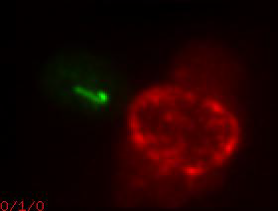
Photobleaching is also a problem
Green – Synapsed chromosome (GFP) Red – Nuclear pore (mcherry)

Slide 22
Ways to Lessen Phototoxicity and Photobleaching Imaging
Remove oxygen and singlet oxygen
Improve detection
Reduce signal
Reduce frequency of exposures
Lower noise
Notes:
Reducing signal - like to monitor what is going on, high signal to noise is better but it is a luxury.

Slide 23
Removing Oxygen and Free Radicals
Removing Oxygen
- Oxyrase - enzyme that removes oxygen
(shown not to be effective with GFP)
Free radical scavengers
- Trolox – derivative of Vitamin E
- ascorbic acid – Vitamin C
- n-Propyl Gallate

Slide 24

Reduce signal
Lowering exposure time
Increasing neutral density filters
Deepstar pulsed lasers – infinite modulation
accurately attain short exposures in nano - microsecond time frame
Notes:
Deepstar laser is a quasi CW (continuous wave) diode laser. What is new is the electronics can modulate current with very high contrast so that you can accurately get very short exposure in the microseconds. The lasers are of equivalent power.

Slide 25
Improve Detection using EMCCD or sCMOS camera
EMCCD – electron multiplying charge coupled device
- low readout noise – 1 electron/pixel
- fast – 30 - 60 Hz (33 – 16 ms per frame)
- quantum efficiency 90-95%
sCMOS – scientific Complementary Metal–Oxide–Semiconductor
- low readout noise – 1 electron/pixel
- faster – 100 Hz (2-3 ms per frame)
- quantum efficiency 50%
Notes:
EMCCD is a quantitative digital camera technology that is capable of detecting single photon events whilst maintaining high Quantum Efficiency, achievable by way of a unique electron multiplying structure built into the sensor.
The words "complementary-symmetry" refer to the fact that the typical digital design style with CMOS uses complementary and symmetrical pairs of p-type and n-type metal oxide semiconductor field effect transistors (MOSFETs) for logic functions.
Lukman says that because quantum efficiency 50% binomial profile for noise vs Poisson
Normal inline CCDs – 6 – 10 electrons/pixel

Slide 26
Reduce frequency of exposures
Bleached/Dead
Bleached/Less Dead
Every 2 min
Every 4 min
Instead of 2x longer before bleaching, you can go 3x as long
Don’t overwhelm endogenous cell antioxidant enzymes
Allow longer time for repair
Notes:
Jason Swedlow who works with mammalian cell lines not only photobleaching reduction and phototoxicity reduction.

Slide 27
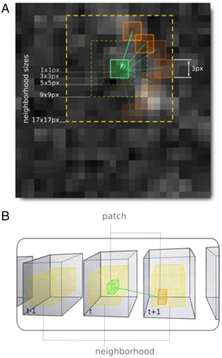
Lowering noise by denoising algorithms
Denoising - The overall strategy is to find regions of the image, which by virtue of similar statistical behavior, are likely to have the same underlying intensity distribution and then average them to reduce noise.
Charles Kervrann
Notes:
In essence, the denoising procedure typically first analyzes the image data for statistical signatures of Poisson and Gaussian noise originating from the limited number of photons (Poisson) and the dark current inherent to electronic imaging detectors (Gaussian). The overall strategy is to find regions of the image, which by virtue of similar statistical behavior, are likely to have the same underlying intensity distribution and then average them to reduce noise.

Slide 28

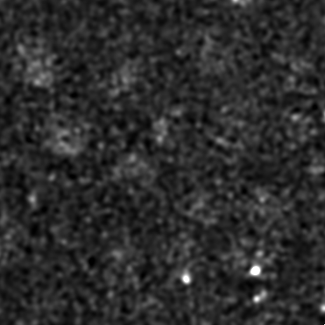
Using denoising to reduce photoxicity
Raw data
Denoised and Deconvolved
LacI-RFP
LacI-RFP
LacI-RFP
LacI-RFP
LacI-RFP
lacO
lacO
lacO
lacO
lacO
Notes:
In essence, the denoising procedure typically first analyzes the image data for statistical signatures of Poisson and Gaussian noise originating from the limited number of photons (Poisson) and the dark current inherent to electronic imaging detectors (Gaussian). The overall strategy is to find regions of the image, which by virtue of similar statistical behavior, are likely to have the same underlying intensity distri- bution and then average them to reduce noise. The challenge is to correctly identify appropriate regions to average.

Slide 29
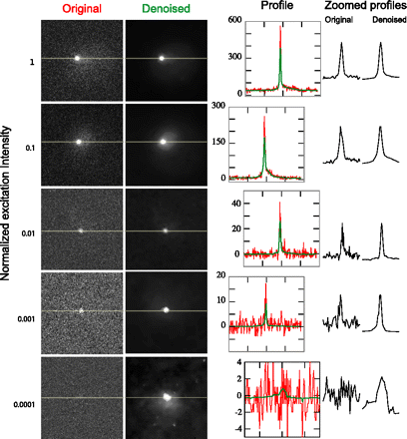
Quantitative Analysis of Improvements Through Denoising

Slide 30
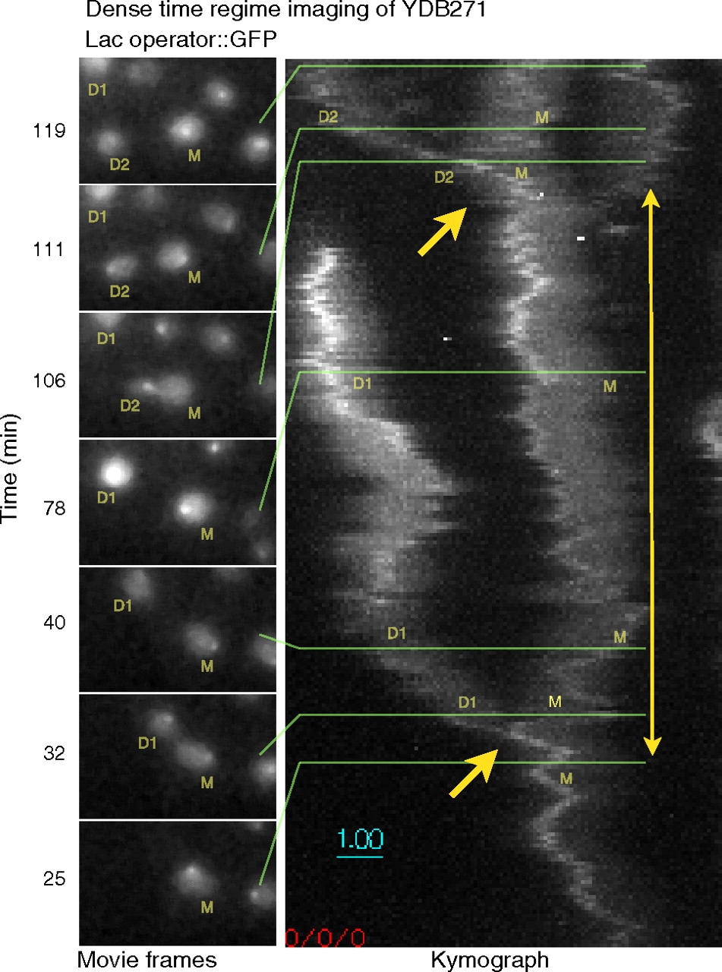
Denoising can improve both phototoxicity and photobleaching
At low light levels (I = 5 × 10-4I0), dense-regime imaging can continue for 2 h, encompassing a whole cell cycle, without fading or loss of viability.
Carlton P M et al. PNAS 2010;107:16016-16022
©2010 by National Academy of Sciences
Notes:
At low light levels (I = 5 × 10-4I0), dense-regime imaging can continue for 2 h, encompassing a whole cell cycle, without fading or loss of viability. The entire series is shown in the SI Text. At left, individual frames from the 2 h imaging sequence, centered on the original cell, are shown proceeding in time from bottom to top. YDB271 yeast cells are labeled M (original mother cell), D1 (first daughter cell), and D2 (second daughter cell). Right, a kymograph created by averaging the 3D stacks in 30 s groups, then projecting the maximum intensity of the time-averaged 3D stacks first along the Z axis, then along the Y axis. Cell divisions are indicated by single arrows; the two-headed arrow delimits an entire cell cycle of the mother cell.

Slide 31
Preserving a normal environment during imaging

Slide 32
Environmental Variables for Mammalian Cell Lines
Variable | Optimum Range | Comments
Temperature | 28-37ºC | Control with Specimen Chamber Heaters Inline Perfusion Heaters Objective Lens Heaters Environmental Control Boxes
Oxygenation | Variable | Perfuse or Change Media Regularly Use Large Chamber Volume
Humidity | 97-100% | Closed chamber, humidified environmental chamber
pH | 7.0 -7.7 | Use Buffered Media, Perfuse or change media, no phenol red indicator
Osmolarity | 260-320 mosM | Avoid evaporation, sealed chamber
Atmosphere | Air or 5-7% C02 | Used Buffered media, closed chamber
Media buffer | Bicarbonate or Synthetic buffers | Beware of phototoxicity, closed & open chambers, atmosphere controlled chamber

Slide 33
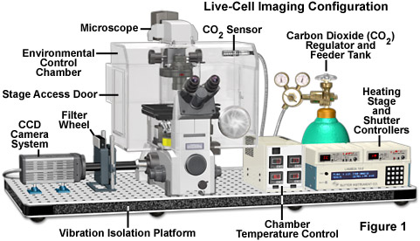
Environmental Chamber

Slide 34
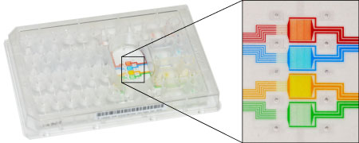
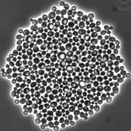
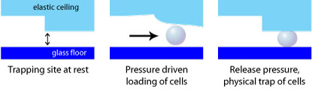
CellASIC – Microfluidic Systems

Slide 35
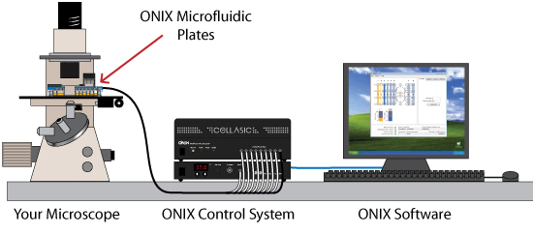
CellASIC – Microfluidic Systems

Slide 36
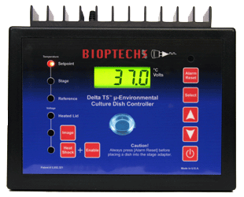
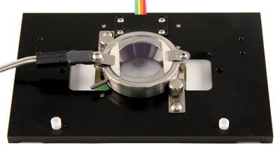
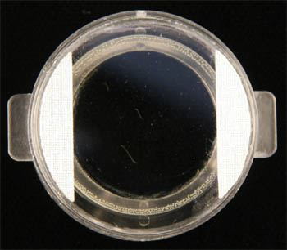
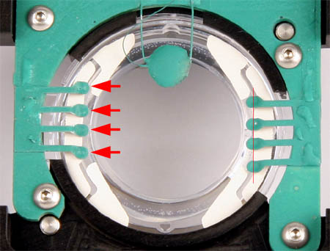
Bioptechs – Open/Closed Dish System
Delta T Dish

Slide 37
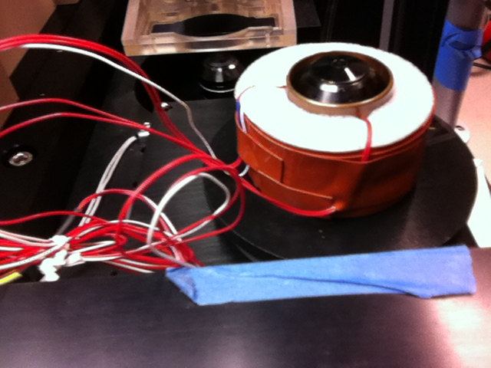
Heated Objective

Slide 38
Custom-made PDMS microfluidics
PDMS - Poly(dimethylsiloxane)
Relatively inexpensive
Easy to use Chemically inert/non-hazardous
Optically clear Flexible and fairly tough when cured
Easily bonded to itself or other materials
Permeable to air and liquids (but can be coated to prevent this).
Notes:
Shrinky dinks

Slide 39
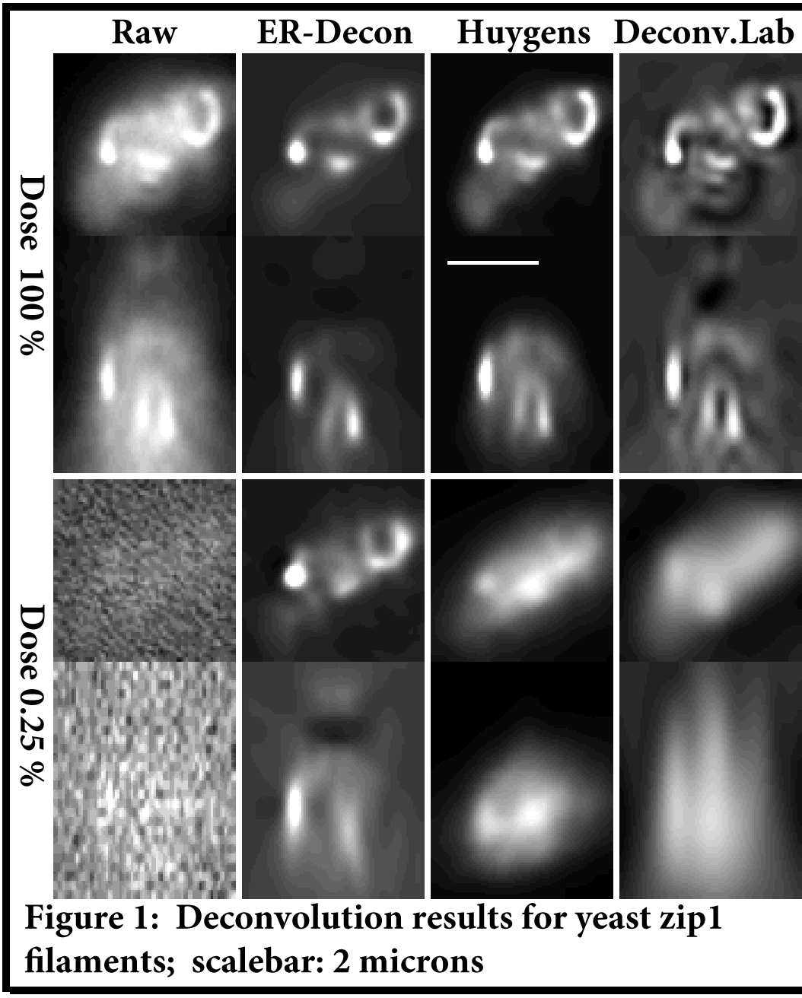
Future Directions
Better reconstruction and denoising algorithms
ER-deconvolution – based on filling CTF with constraints other than positivity
(Entropy regularized deconvolution)
Notes:
Denoising - pixel based method to distinguish signal that statistically using time and space. In stack pixel to pixel differences in time you get signal changes ER-deconvolution - is to fill in the CTF with constraints other than positivity.
We present a novel deconvolution method that uses a regularization functional constructed using an entropy based formalism that is specifically tailored to exploit the spatial characteristics of the fluorescence images. The method has an exceptional power to discriminate the noise high frequencies against signal frequencies and hence leads to high resolution restoration of structures in the presence of large levels of noise.

Slide 40
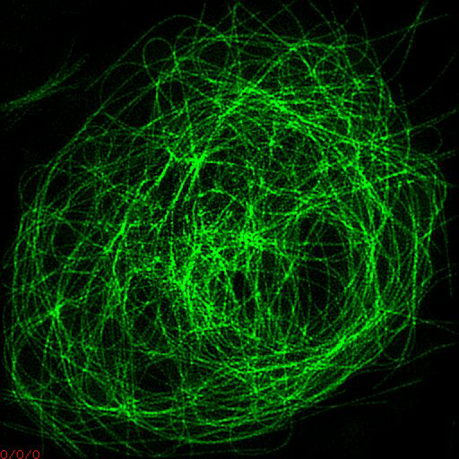
Stay Tuned
In vivo structured illumination microscopy
Tubulin-GFP in Drosophila S2 Cells

Slide 42
Different Goals for Fixed vs. Live
Fixed specimens: Optimize the signal/noise
Live specimens: Optimize the signal/noise but without perturbing
your biological process
Notes:
Among the most significant technical challenges for performing successful live-cell imaging experiments is to maintain the cells in a healthy state and functioning normally on the microscope stage while being illuminated in the presence of fluorescent proteins.

Slide 43
Things to consider for live imaging
Speed – how fast can you take the data, z projections
Detection – how sensitive is you camera, how bright and stable are your fluorophores, level of noise, resolution, stage stability
Environment – microfluidics devices, temperature, phototoxicity,oxygen
Pulsed lasers, chambers, matching objectives
Proper sample – not too deep, not too crowded, synchronized – plenty of examples of biological process, limited duration of biological process, sensitivity to DNA damage
Validation
Data storage and analysis
Denoising, combination of denoising and deconvolution – new directions
Pulsed lasers
Notes:
An increasing number of investigations are using live-cell imaging techniques
to provide critical insight into the fundamental nature of cellular and tissue function

Slide 44
Typical ways to improve S/N in fixed samples
Increase exposure time
Amplify signal
Brighter fluorophores/dyes
Decrease photobleaching with antioxidants
>>>> Increase signal

Slide 45
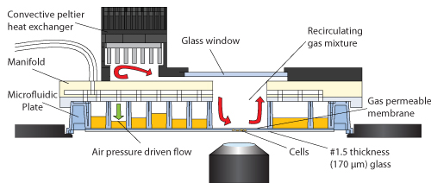
CellASIC – Microfluidic Systems

